Slide 1
Gene-Protein Mapping for MG1655 genome

Slide 2
Remarks
Number of genes in MG1655 = 4288 genes
Maximum gene length = 7152 bases = 2384 amino acids
Minimum gene length = 45 bases = 15 amino acids
Histogram of genes lengths:

Slide 5
Maximum Length = 7152 bases
Minimum Length = 45 bases

Slide 6
Maximum Length = 2384 amino acids
Minimum Length = 15 bases

Slide 7
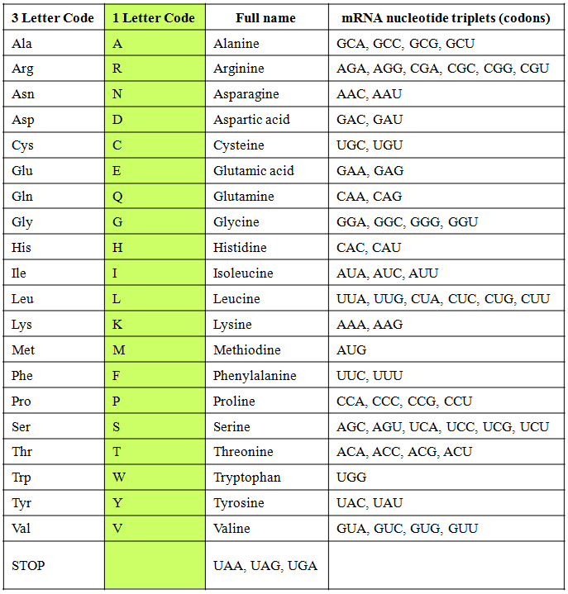
AUGAAUGCUGCUAUUUUCCGCUUCUUUUUUUACUUUAGCACCUGA
M N A A I F R F F F Y F S T Stop

Slide 8
